Slide 1

MODULE 1
DIGITAL DESIGN & COMPUTER ARCHITECTURE
Design & Simulation of a
Digital Alert System Using Logisim
DDCA Group 13 · Project Presentation
Samhita
Mithil
Sampath
Hemanth
2620090087
2620090108
2620090101
2620090109

Slide 2





ROADMAP
What We'll Cover
1
2
3
4
5
System
Overview
Mathematical
Foundations
Circuit
Architecture
Tooling &
Simulation
Key Takeaways
& Conclusion
The big picture
Boolean logic & truth tables
Gates, synthesis & design
Logisim + Git in action
What it all builds toward
A single thread runs through every section: how small, simple building blocks combine into a reliable, real-world system.
DDCA · Group 13 · Digital Alert System
2

Slide 3



PROJECT AT A GLANCE
The Big Picture
CORE LOOP
DIGITAL ABSTRACTION
"We represent each sensor condition as either 0 or 1, and the logic gates use these values to decide whether an alert should be generated."
Input: Sensors detect a condition
Input
Emergency sensors
Analog Signal — Noisy & Unreliable
Process: Logic decides what to do
Process
Logic gate network
Digital Signal — Clean Binary States
Output: Appropriate alert is generated
Output
Alert signal
Only two states: 0 (LOW) and 1 (HIGH) → strong noise immunity
DDCA · Group 13 · Digital Alert System
3

Slide 4



THE MACHINE'S ALPHABET
Requirements & Truth Table
BEHAVIOR RULES
TRUTH TABLE
S1 = Sensor A · S2 = Sensor B · C = Critical Sensor
Idle
S1 | S2 | C | Local | Critical
0 | 0 | 0 | 0 | 0
1 | 0 | 0 | 1 | 0
0 | 1 | 0 | 1 | 0
1 | 1 | 0 | 1 | 0
0 | 0 | 1 | 0 | 1
1 | 0 | 1 | 0 | 1
0 | 1 | 1 | 0 | 1
1 | 1 | 1 | 0 | 1
No sensors are active.
The system remains at rest.
S1 = 0, S2 = 0, C = 0 → No alert
Localized Alert
A standard sensor detects a condition.
The system generates a local alert.
S1 or S2 = 1, C = 0 → Local alert
Critical Alert
The critical sensor detects a condition.
It overrides the standard sensors.
C = 1 → Critical alert
DDCA · Group 13 · Digital Alert System
4

Slide 5

THE MACHINE'S ALPHABET – BINARY LOGIC GATES
The System's Primitives
AND
OR
NOT
XOR
1 only if ALL inputs are 1
1 if ANY input is 1
Inverts the single input
1 only when inputs differ
0,0 | 0
1,0 | 0
1,1 | 1
0,0 | 0
1,0 | 1
1,1 | 1
0 | 1
1 | 0
0,0 | 0
1,0 | 1
1,1 | 0
NAND GATE UNIVERSALITY
A single NAND gate is functionally complete — wired together in different patterns, NAND alone can reproduce AND, OR, NOT, and XOR.
That means our entire alert system — every rule on the previous slide — could be rebuilt from nothing but NAND gates. Small primitives, unlimited scale.
DDCA · Group 13 · Digital Alert System
5

Slide 6
THE MACHINE'S ALPHABET
Truth Table → Circuit
DEFINE THE RULES
DESIGN THE LOGIC
BUILD AND TEST
Identify the sensor inputs.
Decide what each sensor represents.
Define when a Local Alert should occur.
Define when a Critical Alert should occur.
Write the expected output for each condition
Create a truth table for all possible inputs.
Convert the required behavior into a Boolean expression.
Simplify the expression where possible.
Select the required logic gates.
Connect the gates according to the Boolean logic.
Build the circuit in Logisim.
Connect the sensor inputs and alert outputs.
Change the inputs to simulate different conditions.
Compare the actual outputs with the truth table.
Check that the system responds correctly in every case.
DDCA · Group 13 · Digital Alert System
6

Slide 7
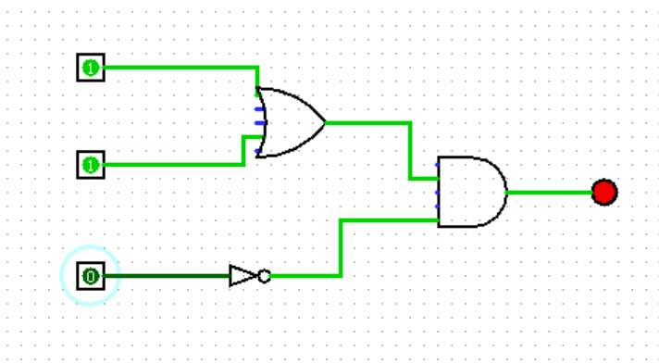
TOOLING & WORKFLOW
Logisim component | Represents | Function
S1 switch | Standard Sensor A | Gives 0 or 1 depending on whether the sensor is active
S2 switch | Standard Sensor B | Gives 0 or 1 depending on whether the sensor is active
C switch | Critical Sensor | Gives 0 or 1 depending on whether a critical condition is detected
NOT gate | Critical condition check | Converts C into C’
OR gate | Standard sensor combination | Gives 1 if S1 or S2 is active
AND gate | Local-alert decision | Produces Local only when a standard sensor is active and C is 0
Local LED | Localized Alert | Turns ON when a standard sensor triggers without a critical condition
Logisim Architecture
THE LOGISIM CANVAS
Real-time simulation: signal states update instantly as inputs change.
DDCA · Group 13 · Digital Alert System
7

Slide 8

TOOLING & WORKFLOW
Simulation & Edge Cases
STANDARD OPERATION
CRITICAL / EDGE CASES
Verified against every non-critical row of the truth table.
Stress-tested to confirm the circuit fails safely, never silently.
No sensors active
Critical sensor fires alone
System stays Idle — output 0,0
Critical Alert overrides Idle instantly
One sensor triggers
Critical + standard sensors together
Localized Alert fires correctly
Critical Alert still wins — no conflict
Both standard sensors trigger
All sensors trigger simultaneously
Localized Alert holds, no false Critical
Output remains stable and deterministic
DDCA · Group 13 · Digital Alert System
8

Slide 9
PROJECT SUMMARY
Key Takeaways
Small, reliable building blocks — combined with discipline — create big, reliable systems. That is the throughline from this alert circuit to real computer architecture.
4
3
Reliable Architecture
The same principles scale to full computer systems
2
SOP Synthesis
Boolean equations bridge logic and physical hardware
1
Rigorous Design
Truth tables give a provably complete specification
Logic Primitives
Gates are the atomic units of every digital system
DDCA · Group 13 · Digital Alert System
9

Slide 10
THANK YOU
DDCA Group 13 · Digital Alert System Using Logisim
Samhitha
Mithil
Sampath
Hemanth
2620090087
2620090108
2620090101
2620090109
Questions & Discussion

